Slide 1


Time Series Final Project: Analysis and Forecasting of Light Weight Vehicle Sales Time Series.
IBM Machine Learning Professional Certificate
Course 06: Specialized Models: Time Series and Survival Analysis
By Mohamad Osman

Slide 2
Contents
Dataset Description
Main objectives of the analysis.
EDA, Data Cleaning, Feature Engineering
Time series Forecasting & ML/DL Analysis and Findings
Models flaws and advanced steps.

Slide 3
Abstract
In this report we are trying to explore a dataset of light weight vehicle sales in USA from 1976 to 2022 using time series techniques , in order to forecast the sales for future periods to help the owners of lightweight vehicles showrooms in USA to draw conclusions and insights and make right decision of their business.

Slide 4
Data Description Section

Slide 5
Dataset Description
Dataset Info:
Label : Light Weight Vehicle Sales (LTOTALNSA)
Source: U.S. Bureau of Economic Analysis
Release: Supplemental Estimates, Motor Vehicles
Units: Thousands of Units, Not Seasonally Adjusted
Frequency: Monthly
Citation: U.S. Bureau of Economic Analysis, Light Weight Vehicle Sales [LTOTALNSA], retrieved from FRED, Federal Reserve Bank of St. Louis; https://fred.stlouisfed.org/series/LTOTALNSA, May 23, 2022.

Slide 6
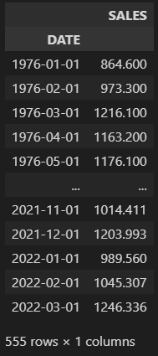
Dataset Description
Importing the dataset into a data frame & describing the attributes
The dataset consists of two columns:
DATE
LTOTALNSA (relabeled to “SALES”)
DATE : contains monthly dates from 1976 – 2022
For instance: 1976-04-01 (YYYY-MM-DD)
SALES: contains monthly light weight vehicle sales in thousands of units
For instance : 1163.2 thousand of vehicle (1163200 units) are sold in this date.
Number of records :
555 rows

Slide 7
Main Objective of the analysis:
In this analysis we will explore the dataset of monthly Lightweight Vehicle Sales in USA from 1976 to 2022 in more details for the sake of approaching time series techniques and models in order to help the owners of lightweight vehicles showrooms in USA to draw the conclusions and insights and make the right decision of their business.

Slide 8
Exploratory Data Analysis (EDA) + Feature Engineering Section

Slide 9
Exploratory Data Analysis
We are going to apply different tests & analysis to check each of :
White Noise:
Time series can be considered as white noise (can’t be modeled for forecasting) if it satisfies three conditions :
Approximately zero mean over the time series.
Constant standard deviation over the time series.
Specific patterns in the correlations between the time series and its lags.
Stationarity:
In order a time series data to be stationary, the data must exhibit four properties over time:
constant mean
constant variance
constant autocorrelation structure
no periodic component

Slide 10
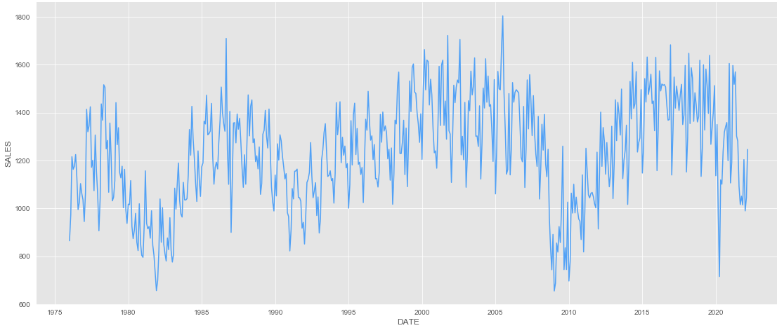
Exploratory Data Analysis
Time series visualization
LTOTALNSA Timeseries Visualization

Slide 11
Exploratory Data Analysis
Time Series General Features :
we can extract from the graph the following features:
There is no trend in other words Stationary trend which indicates a constant mean.
The variance is constant.
The graph does not show a periodic component (no seasonality)

Slide 12
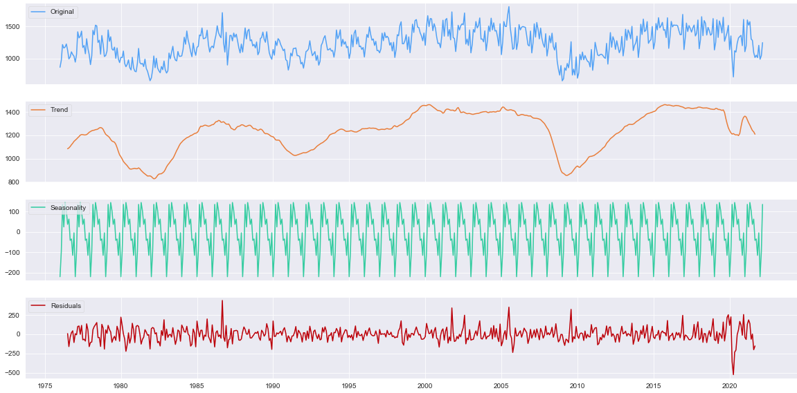
Exploratory Data Analysis
Timeseries Decomposition :
the decomposition process has the same results if it is either done by additive or multiplicative model.
Trend: there is no trend (stationary trend )
Seasonality: It is estimated as an additive seasonality
Note: The decomposition model estimates the existence of a seasonality or a seasonal component, but this doesn’t mean it has one (it is better to extract the seasonality from the original series in the cyan color).

Slide 13
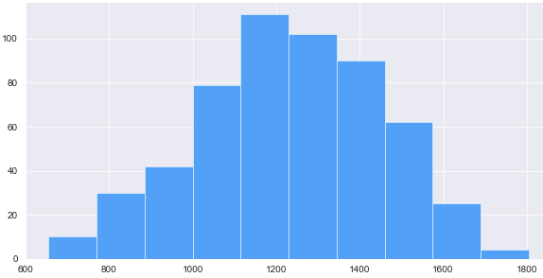
Exploratory Data Analysis
Plotting Time Series Values as Histogram Graph
Plotting a histogram of the time series gives important clues into its underlying structure. A Normal distribution gives confidence that mean, and variance are constant. It's certainly not definitive but gives you a good indication.

Slide 14
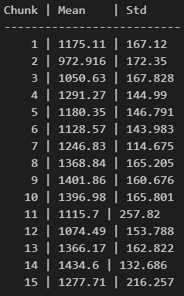
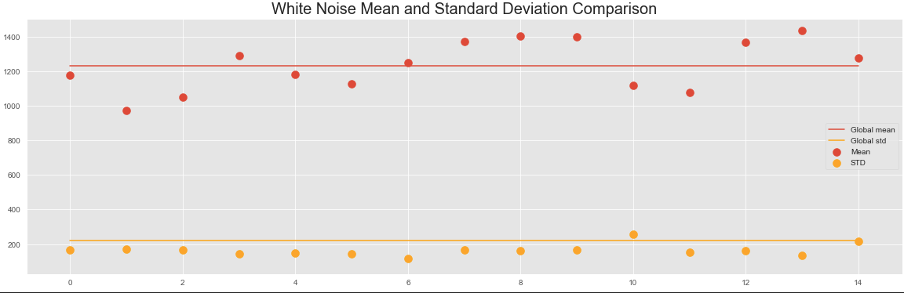
Exploratory Data Analysis
Finding means & standard deviations of time series chunks:
As shown all chunks have approximately closed mean values where they range between 1100 & 1400 (non-zero mean) which refers to a time series does not behave as white noise, standard deviations range mostly between 140 & 160 with existence of a little bit of variance.

Slide 15
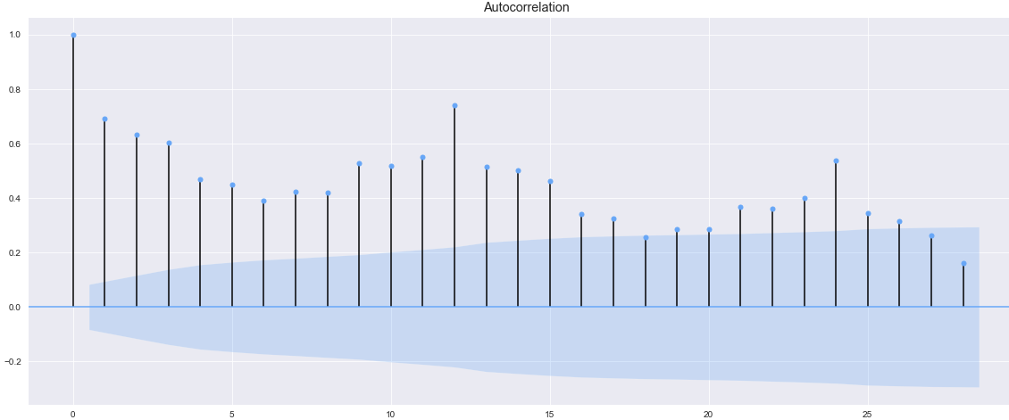
Exploratory Data Analysis
Autocorrelation plots:
As shown in the plot above the most majority of the correlations between the time series lags are statistically significant since it is out of the confidence interval (shaded area), and they are decreasing gradually.

Slide 16
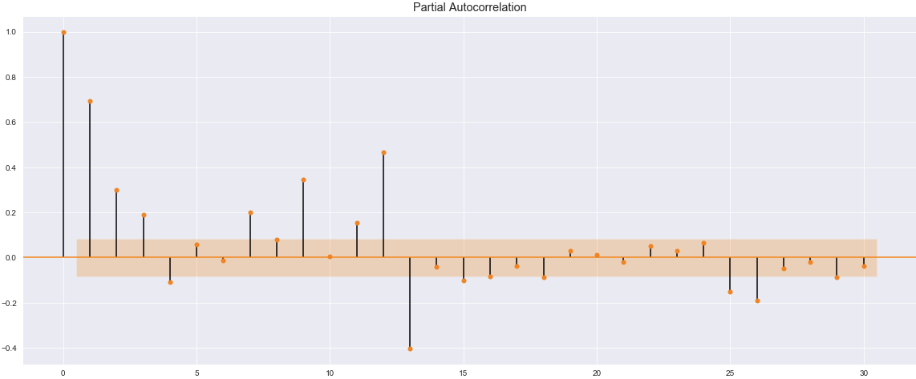
Exploratory Data Analysis
Partial Autocorrelation plot
We have a moderate correlation between original time series and lag 12

Slide 17
Exploratory Data Analysis
Augmented Dickey-Fuller Test
This is a statistical procedure to discover whether a time series is stationary or not.
We won't go into all the nitty gritty details but here's what you need to know:
Null hypothesis: the series is nonstationary.
2. Alternative hypothesis: the series is stationary.
Like any statistical test you should set a significance level or threshold that determines whether you should accept or reject the null.
The value 0.05 is common but depends upon numerous factors.
Let's see the result in the next slides.

Slide 18
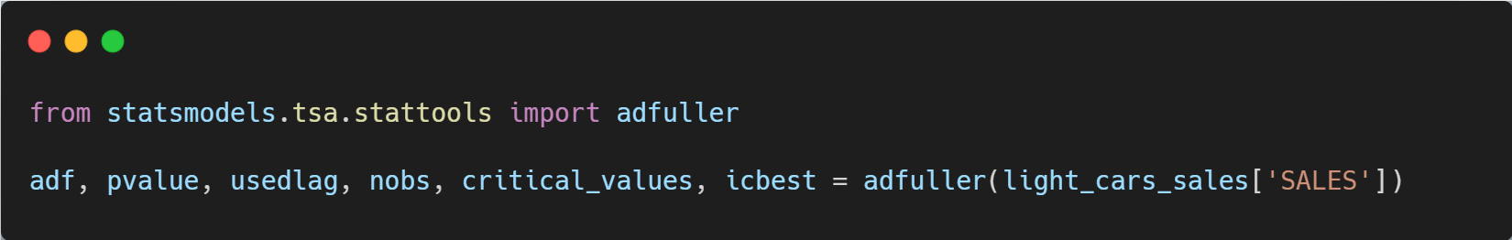
Exploratory Data Analysis
Augmented Dickey-Fuller Test
adf = -2.829277524541586
First, adf is the value of the test statistic. The more negative the value, the more confident we can be that the series is stationary. Here we see a value of -2.83. That may not mean anything to you just yet, but the p-value should.
A brief discussion about the important outputs from the ADF test is in order.
Pvalue = 0.05421184907221919
p-value is interpreted like any p-value. Once we set a threshold, we can compare this p-value to that threshold. Either we reject or fail to reject the null. Here p-value is very close to zero “0.054” so we reject the null that this data is nonstationary, and we can conclude that it is a stationary time series.
critical_values = {'1%': -3.442609129942274, '5%': -2.866947348175723, '10%': -2.569649926626197}
Finally, the critical_values variable provides test statistic thresholds
for common significant levels. Here we see a test statistic of roughly -2.86
and lower is sufficient to reject the null using a significance level of 5%.

Slide 19
Exploratory Data Analysis
Analysis Summary:
White Noise:
Time series can be considered as white noise (can’t be modeled) if it satisfies three conditions :
Approximately zero or exactly zero mean over the time series. [not satisfied]
Constant standard deviation over the time series. [satisfied]
correlations between the time series and its lags are not statistically significant. [not satisfied]
Final Decision: Time series is not considered a white noise.
Stationarity:
In order a time series data to be stationary, the data must exhibit four properties over time:
constant mean [satisfied]
constant variance [satisfied]
constant autocorrelation structure [satisfied]
no periodic component [satisfied]
Final Decision: Time series is considered stationary.

Slide 20
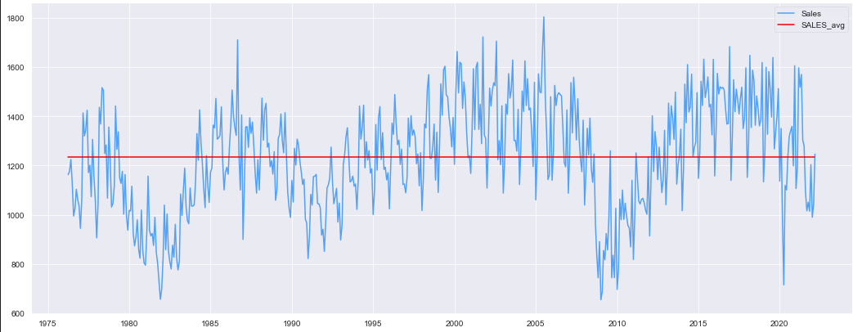

Feature Engineering
Smoothing Time Series
1 -Simple Smoothing

Slide 21
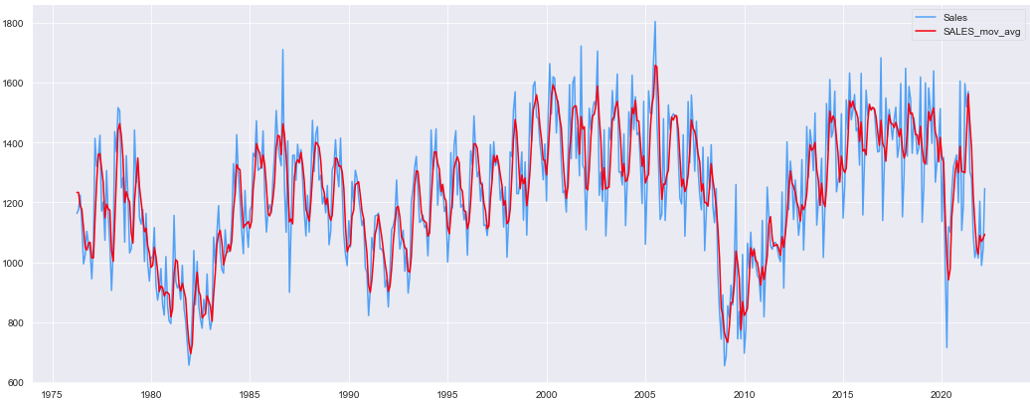

Feature Engineering
Smoothing Time Series
2 - Moving Average Smoothing

Slide 22
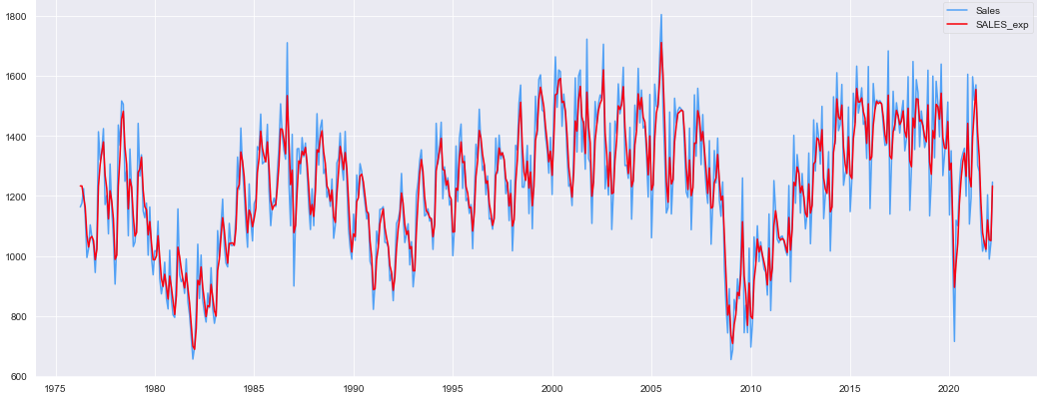

Feature Engineering
Smoothing Time Series
3 - Exponential Smoothing

Slide 23
Time series Forecasting & ML/DL Analysis and Findings

Slide 24
Machine Learning Analysis & Findings
In the following slides we will test different forecasting techniques to predict the time series starting from smoothing, ML techniques and ending with deep learning.
Then we will choose the best technique to be adopted as forecasting model for our light weight vehicles sales dataset.

Slide 25
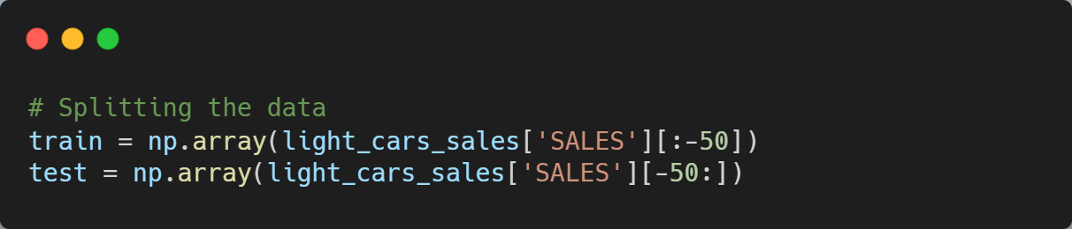
Time series Forecasting & ML/DL Analysis and Findings
1- Forecasting using Smoothing
Splitting the data into train and test sets.
Training set : 502 observations.
Testing set : 50 observations.

Slide 26
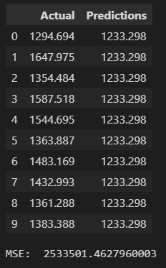
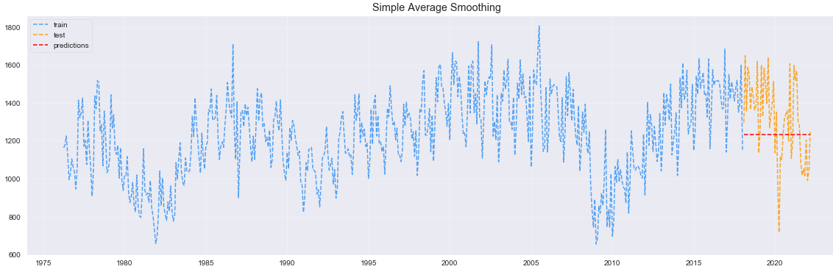
Time series Forecasting & ML/DL Analysis and Findings
1- Forecasting using Smoothing
1.1 Forecasting by Simple Average
Obviously, we can see a high error between the predictions and actual values.
Mean Square Error : 2533501 !

Slide 27
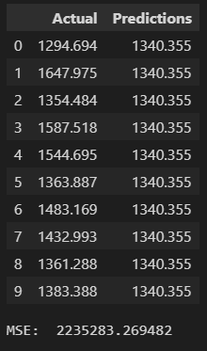
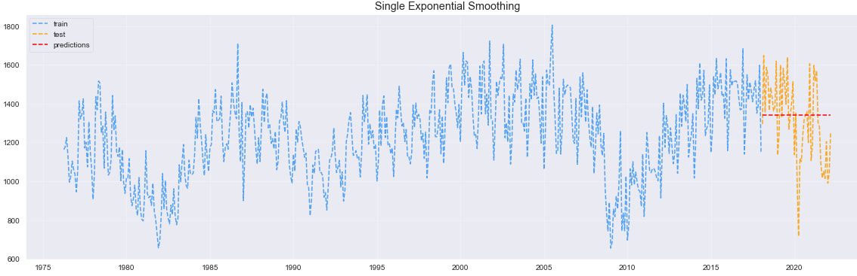
Time series Forecasting & ML/DL Analysis and Findings
1- Forecasting using Smoothing
1.2 Forecasting by Single Exponential
The results enhanced a little bit, but as the same time, we can see a high error
relatively between the predictions and actual values.
Mean Square Error : 2235283 !

Slide 28
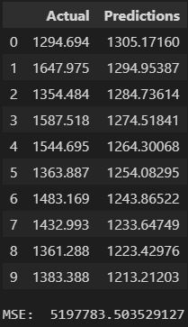
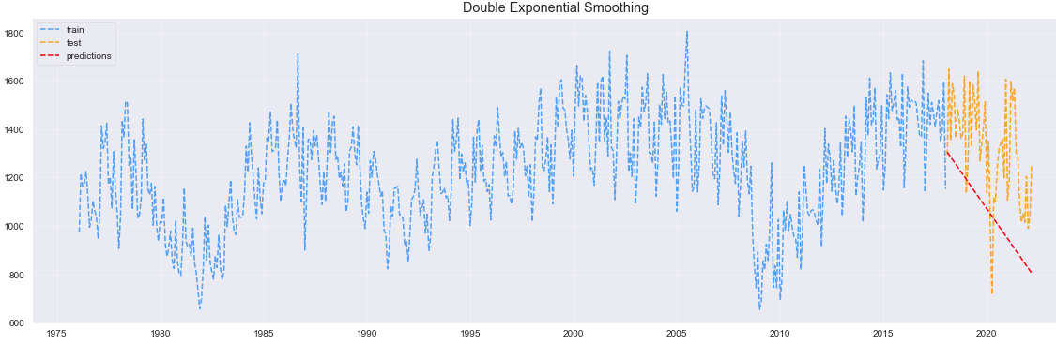
Time series Forecasting & ML/DL Analysis and Findings
1- Forecasting using Smoothing
1.3 Forecasting by Double Exponential
Same here, we can see the highest error between the predictions and actual values.
Mean Square Error : 5197783 !

Slide 29
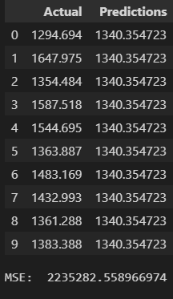
Time series Forecasting & ML/DL Analysis and Findings
1- Forecasting using Smoothing
1.4 Forecasting by Triple Exponential
Triple exponential technique achieved the same result of single exponential smoothing technique.
Mean Square Error : 2236924 !

Slide 30
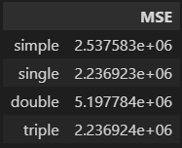
Time series Forecasting & ML/DL Analysis and Findings
Comparison between smoothing techniques predictions.
As shown in the DataFrame on the right, single and triple exponential achieved the best results, where the worst forecasting was with double exponential smoothing, but all these forecasting techniques are considered unreliable since they led to very high error, in the next slides we will use better forecasting models and techniques.

Slide 31
Time series Forecasting & ML/DL Analysis and Findings
Using Autocorrelation to choose appropriate model.
SHAPE | MODEL
Exponential Decaying to zero | AR models
Alternating positive and negative decaying to zero | AR models
One or more spikes, the rest are close to zero | MA model
Decay after a few lags | Mixed AR and MA
All zero or close to zero | Data is random
High values at fixed intervals | Include seasonal AR term
No decay to zero | Series is not stationary

Slide 32
Time series Forecasting & ML/DL Analysis and Findings
Using SARIMA model for forecasting.
Some rules to highlight from the Duke ARIMA Guide:
If the series has positive autocorrelations out to a high number of lags, then it probably needs a higher order of differencing.
If the lag-1 autocorrelation is zero or negative, or the autocorrelations are all small and pattern less, then the series does not need a higher order of differencing. If the lag-1 autocorrelation is -0.5 or more negative, the series may be over-differenced. BEWARE OF OVERDIFFERENCING!!
A model with no orders of differencing assumes that the original series is stationary (mean-reverting). A model with one order of differencing assumes that the original series has a constant average trend (e.g. a random walk or SES-type model, with or without growth). A model with two orders of total differencing assumes that the original series has a time-varying trend (e.g. a random trend or LES-type model).

Slide 33
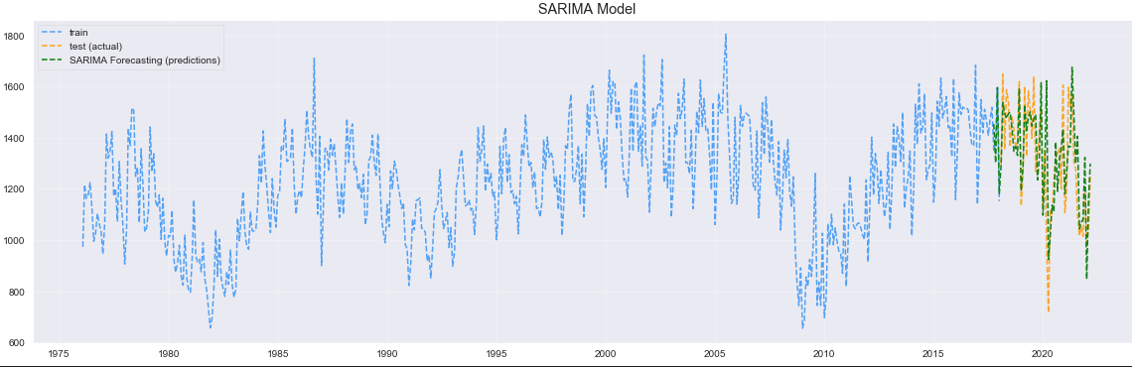
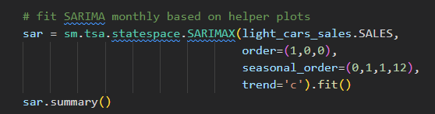
Time series Forecasting & ML/DL Analysis and Findings
2- Forecasting using SARIMA model (Seasonal Average Integrated Moving Average)
2.1 Forecasting using SARIMA model SARIMA (p, d, q) (P, D, Q).
As shown in the figure above we got much better predictions using SARIMA model

Slide 34
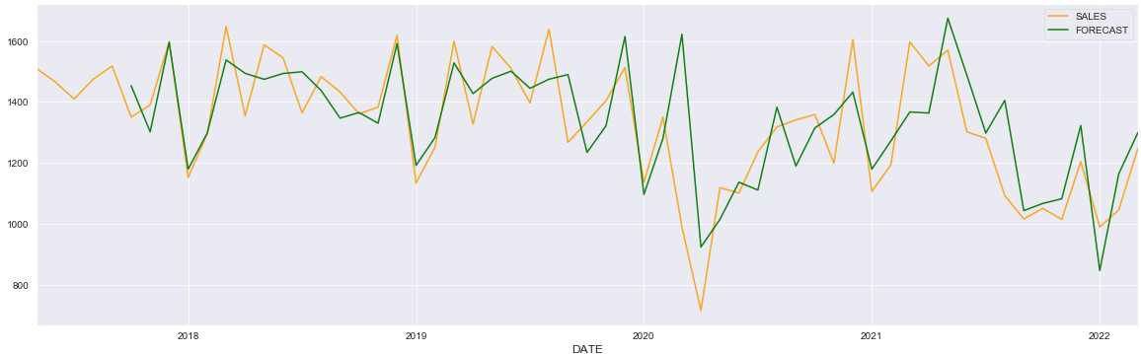

Time series Forecasting & ML/DL Analysis and Findings
A closer look on last 50 values that forecasted using SARIMA model.
Mean Square Error : 1085655 !
Noticeably, the mean squared error of forecasting by SARIMA become half lesser than the forecasting by smoothing which is considered a measurable advance.

Slide 35
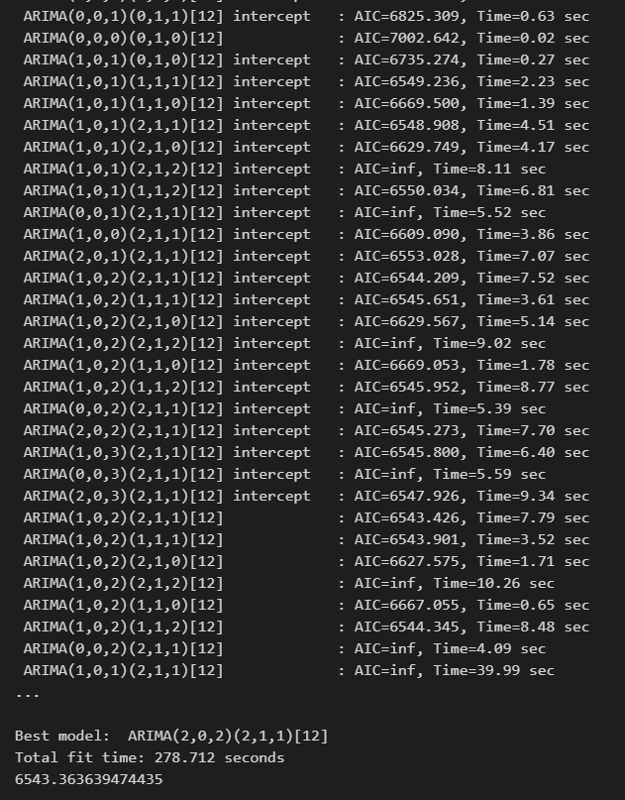
Time series Forecasting & ML/DL Analysis and Findings
2- Forecasting using SARIMA model (Seasonal Average Integrated Moving Average)
2.2 SARIMA model and parameters tuning : SARIMA (p, d, q) (P, D, Q).
After about 5 mins of searching about the best SARIMAS Parameters that fits with our cars sales data we got the following results:
Best model: ARIMA(2,0,2)(2,1,1)[12]
Total fit time: 278.712 seconds
AIC: 6543.363639474435
Now we are going to fit these parameters with a SARIMA model and test the model in terms of achieving correct forecasting.

Slide 36
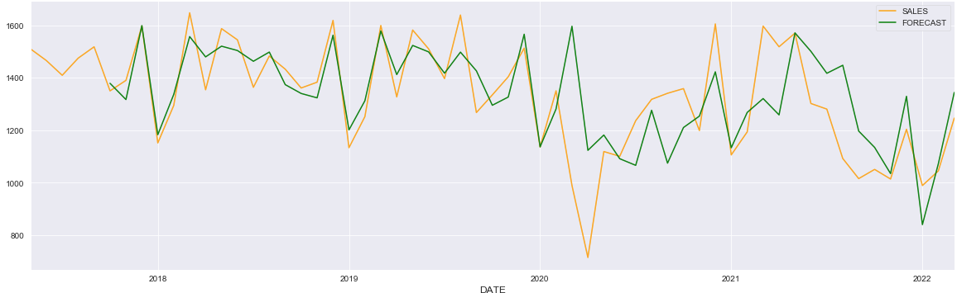
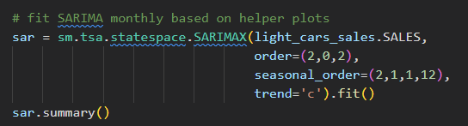
Time series Forecasting & ML/DL Analysis and Findings
2- SARIMA model and parameters tuning
the previous model achieved a better results in terms of MSE compared to this model, but still the difference is between two models is so small.

Slide 37
Time series Forecasting & ML/DL Analysis and Findings
2- Forecasting using SARIMA model (Seasonal Average Integrated Moving Average)
2.2 SARIMA model and parameters tuning : SARIMA (p, d, q) (P, D, Q).
After about 5 mins of searching about the best SARIMAS Parameters that fits with our cars sales data we got the following results:
Best model: ARIMA(2,0,2)(2,1,1)[12]
Total fit time: 278.712 seconds
AIC: 6543.363639474435
Now we are going to fit these parameters with a SARIMA model and test the model in terms of achieving correct forecasting.

Slide 38
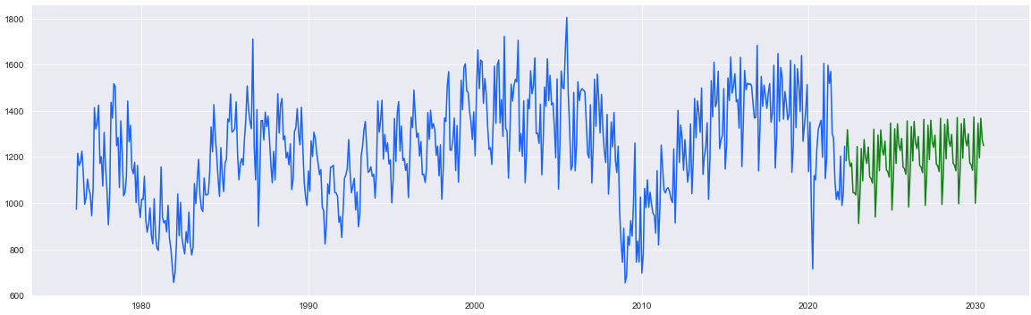
Time series Forecasting & ML/DL Analysis and Findings
2- SARIMA model and parameters tuning
2.3 SARIMA Future Forecasting

Slide 39
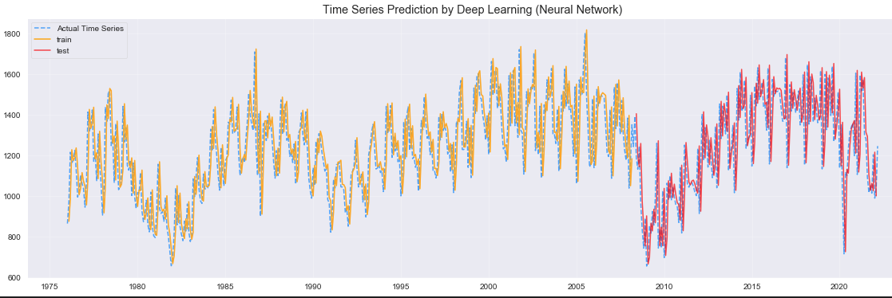

Time series Forecasting & ML/DL Analysis and Findings
3- Time Series Prediction by Deep Learning (Neural Network)
3.1 Neural Network Prediction.

Slide 40
Models flaws and strengths and advanced steps

Slide 41
Models' strengths and flaws
Models Strengths and Flaws:
Generally, Time series modeling & forecasting is considered one of the hardest problems to approach in data science since it depends on large amount of analysis and work, as shown in the previous slides we exposed to several techniques, where we compare between them in terms of forecasting one of these techniques was forecasting by smoothing which provided the worst results but at the same time it gave us intuition that the time series can be predicted by more advanced techniques like SARIMA model which provided very good results, and neural networks which gave us the best results, at the same time these models achieved good results to some extent in terms of forecasting future series.

Slide 42
Advanced steps further suggestions:
As shown in the previous slides deep learning models achieved the best results in order of modeling and forecasting time series and we can go further with the results by using more advanced techniques such as :
Recurrent neural network (RNN)
Long short-term memory LSTM.
I am currently working on these models to find out its strengthens and weaknesses and will be uploaded on my GitHub account soon.
https://github.com/AI-MOO/IBM-Machine-Learning-Professional-Certificate

Slide 43
Thank you
IBM Machine Learning Professional Certificate
Specialized Models: Time Series and Survival Analysis
By: Mohamad Osman

